Slide 1


Case Study on Chrome OS
Under the guidance of
Mr Vedamurthy H K
Prepared by:
Subramanya G
Swaroop Kumar

Slide 2
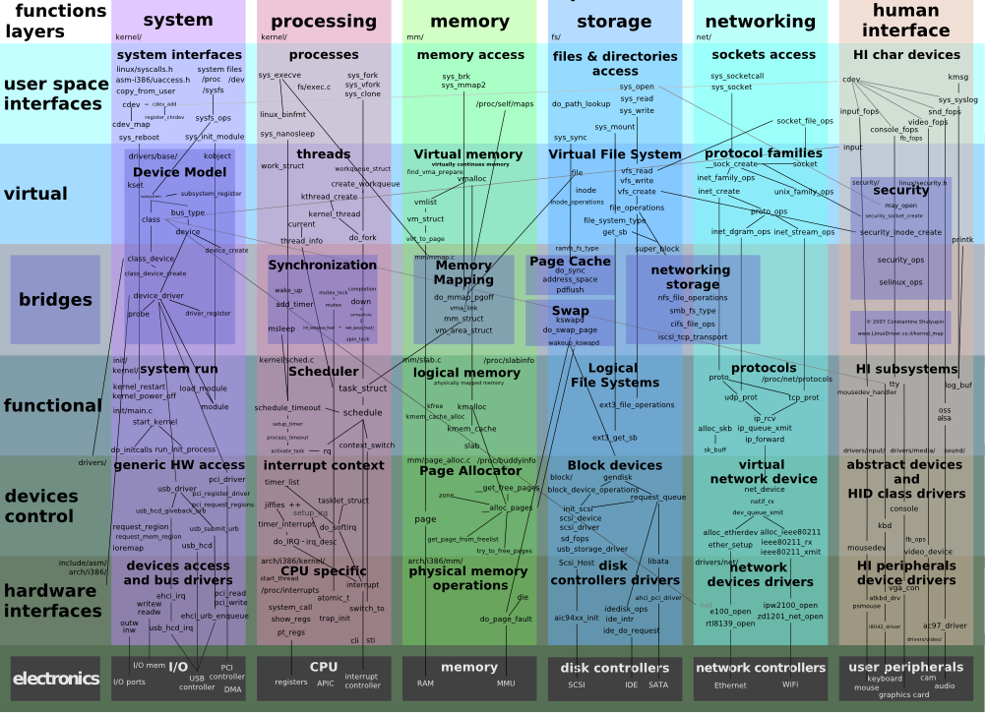
Chrome OS Kernel Map

Slide 3
Design of firmware
Chrome OS consists of three major components:
The Chromium-based browser and the window manager
System-level software and user-land services: the kernel, drivers, connection manager, and so on
Firmware

Slide 4
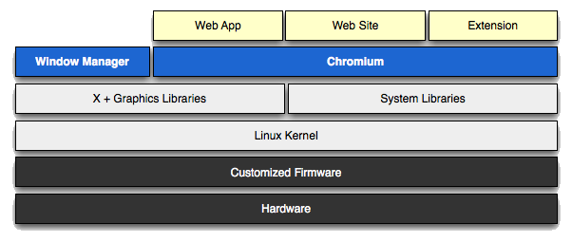
Architecture

Slide 5
Firmware
The firmware plays a key part to make booting the OS faster and more secure. To achieve this goal Chrome OS has removed unnecessary components and adding support for verifying each step in the boot process. Chrome OS also support for system recovery into the firmware itself. This can avoid the complexity that's in most PC firmware because They don't have to be backwards compatible with a large amount of legacy hardware. For example, we don't have to probe for floppy drives.
Chrome OS firmware has implemented with the following functionality:
System recovery: The recovery firmware can re-install Chrome OS in the event that the system has become corrupt or compromised.
Verified boot: Each time the system boots, Chrome OS verifies that the firmware, kernel, and system image have not been tampered with or become corrupt. This process starts in the firmware.
Fast boot: They have improved boot performance by removing a lot of complexity that is normally found in PC firmware.

Slide 6
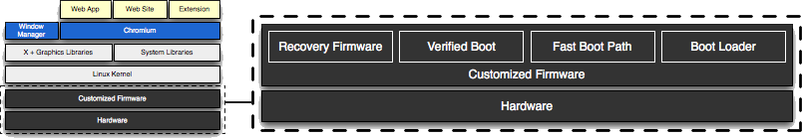
High level design of the firmware

Slide 7
Firmware Boot and Recovery
The layout and structure of firmware for Chrome OS is designed for security, recovery and development.
All firmware will contain a recovery code path, which will restore the machine to its original Chrome OS state. This recovery code path will be initiated either when any chain in the boot path is not verified or when a user manually triggers recovery mode, likely via an explicit recovery button on the device.
Chrome OS wants to support developers as well. Developers are provided with a means of running alternate software. In the alternate boot paths, the user is notified that they are not running a boot path provided as part of Chrome OS.
The boot and recovery procedures outlined will be implemented and required for all Chrome OS platforms regardless of architecture (ARM/Intel/etc...).

Slide 8
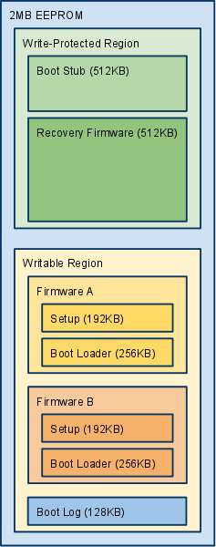
EEPROM map
Boot stub:
Must be at the top of EEPROM, since most processors jump to the top of memory (0xFFFFFFF0) after internal initialization. Contains the "root key" - the official public key used to verify the signature of the next stage of firmware. The private key is not contained on the device, and must be protected from all unauthorized access. To reduce exposure of the private root key, the private root key will be used to sign a second date-limited or numbered key stored in the rewritable firmware, which is then used to sign that firmware. Validation of the date or key number could be done via a TPM module.
Pseudocode
Initialize processor and RAM (and implicitly, those parts of the north bridge necessary to initialize RAM), using conservative timings.
If user-forced recovery mode, skip to attempt loading recovery firmware. (The recovery button asserts an I/O line that can be measured by the firmware.)
Check the non-volatile register or memory region for a recovery mode cookie value. If this is set, some later stage of the boot process must have failed and requested recovery mode, so skip to attempt loading recovery firmware.
Attempt loading Firmware A.
Copy Firmware A to RAM.
Verify signature of Firmware A using public key stored in boot stub.
If signature is valid, jump to Firmware A Setup.
Firmware A is bad. Repeat for Firmware B.
Both A and B are bad. Attempt loading recovery firmware to RAM and verify signature. If valid, jump to recovery firmware.
All recovery options have been exhausted. Catch fire / emit POST code / etc.

Slide 9
Firmware (A/B) setup
This firmware sets up a minimal set of hardware components so that the boot loader can load the kernel from the normal boot drive. For example, the SATA or eMMC controller.
Pseudocode
Initialize chipset / file system sufficiently to jump to Boot Loader code.
Jump to Boot Loader code.
Firmware (A/B) boot loader
The boot loader is only designed to load Chromium OS. We can go directly from firmware bootstrap to the kernel in the disk.
Pseudocode
Verify the partition table on the disk looks sane.
Load kernel A from the disk.
Verify signature of kernel.
If signature is invalid:
If this is kernel A, retry with kernel B.
Else this is kernel B. Both kernels are bad, so set the recovery-mode cookie non-volatile register and reboot into recovery firmware.
If kernel was signed with a public key not known to the boot loader, this is a developer kernel:
Initialize the display.
Display scary developer mode warning to user. For example: "Google Chrome OS is not installed. Press space bar to repair."
Wait for keypress or 30-second delay before continuing.
If key pressed was Space bar, Enter, or Esc, jump to Recovery Firmware.
If key pressed was Control+D, dismiss screen.
Ignore other key presses.
Continue booting the kernel.

Slide 10
Boot flowchart
The three main downward flows in boot flowchart is:
Start of boot in read-only firmware
Normal continuation of boot, loading kernel from internal drive
Recovery mode

Slide 11
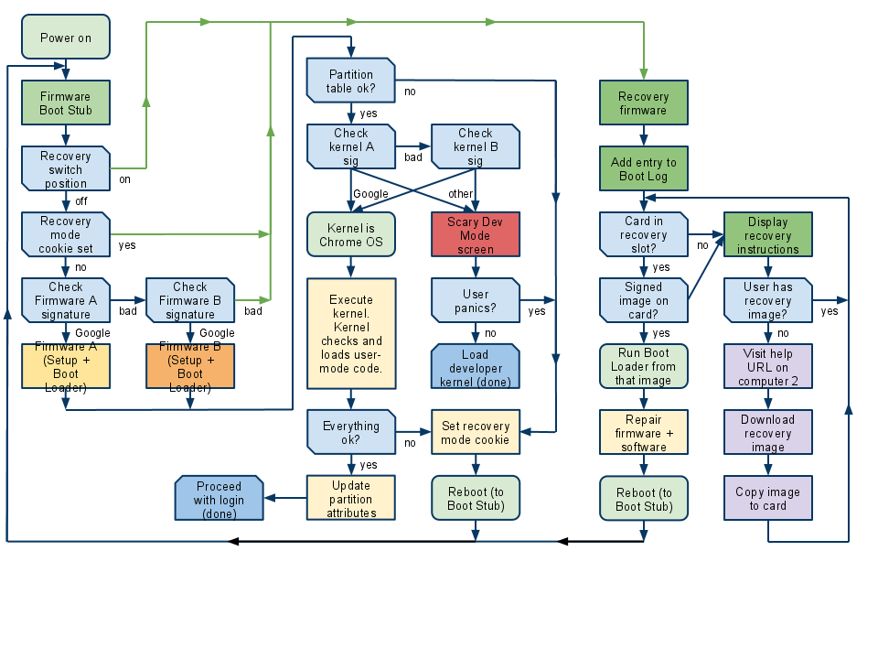
Boot flowchart

Slide 12
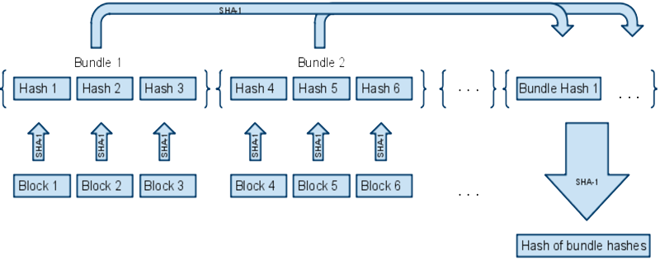
Extending verification from the kernel on upward
The Chrome OS team is implementing a verified boot solution that strives to ensure that users feel secure when logging into a Chromium OS device. Verified boot starts with a read-only portion of firmware, which only executes the next chunk of boot code after verification.
Verified boot strives to ensure that all executed code comes from the Chrome OS source tree, rather than from an attacker or corruption.
Verified boot is focused on stopping the opportunistic attacker. While verified boot is not expected to detect every attack, the goal is to be a significant deterrent which will be improved upon iteratively.
Verification during boot is performed on-the-fly to avoid delaying system start up. It uses stored cryptographic hashes and may be compatible with any trusted kernel.

Slide 13
Verified Boot Data Structures
Basic Guidelines
Structures are versioned
Versioning allows readers to check for older/newer structures. This feature lets us add fields to the structures without necessarily breaking old readers and provides an upgrade path for newer readers to handle old structures. Versioning structures will resolve the issue where kernel and firmware must be updated in unison. Structures have a major and minor version number.
ReaderMajor != StructureMajor - fundamental change in struct; do not attempt to parse
ReaderMinor == StructureMinor - all is well
ReaderMinor < StructureMinor - reading a newer file; fields have been added to the struct, but the existing reader will be able to ignore them and still function
ReaderMinor > StructureMinor - reading an older file; reader won’t find the fields added since version StructureMinor, and should use default values for those fields

Slide 14
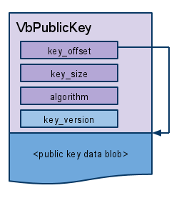
Key structures keep track of their own key version and algorithm
While public keys generally have some internal structure, it’s not always apparent. We can use various sizes and algorithms for different keys , so they’ve defined a VbPublicKey structure that simply encapsulates the public key data along with its size and algorithm

Slide 15
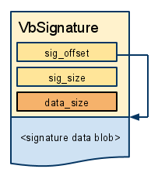
VbSignature structures are very similar, but instead of the algorithm and version they only remember the length of data they signed. A signature data blob is usually a hash that has been encrypted with a private key. The corresponding public key must be used to extract the original hash. In some cases we may also use a VbSignature structure for a nonencrypted hash.

Slide 16
The public key and signature headers know how to find their data
Given a pointer to the VbPublicKey or VbSignature header, you can find the corresponding data, which may not be immediately following the header itself. This lets us put the header structs as sub-structs in the major structures (preambles, etc.), followed by the data, without needing to pass in data pointers separately.
Functions should take header pointers rather than raw data wherever possible.
Common structures are reused
Keys, signatures, and key blocks are used by firmware and kernel algorithms. Common code for generating and parsing is reused.

Slide 17
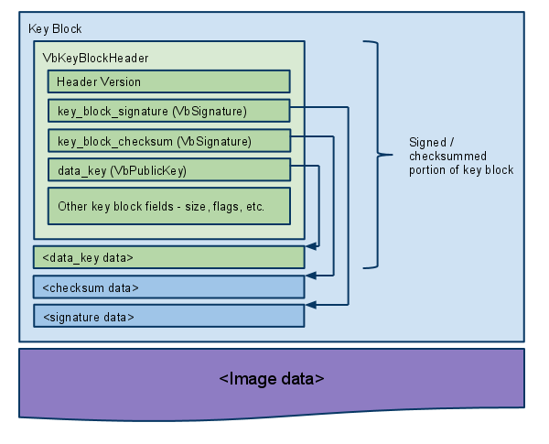
Major structure Key block
At the beginning of a firmware or kernel image is a key block that contains the subkey used to sign the rest of the data in the image. The subkey itself is signed by some higher key, which is presumably more secure or robust.
The key block itself is either signed (by Google) or simply checksummed (for self-signed developer images), so only one of the two VbSignatures is used to validate it. The reason we have two VbSignatures in the key block header is so that we can build one image that can be validated in either way, which makes testing and development much simpler.
This key block structure is identical for firmware and kernel images, so the code to create and verify it can be shared.

Slide 18
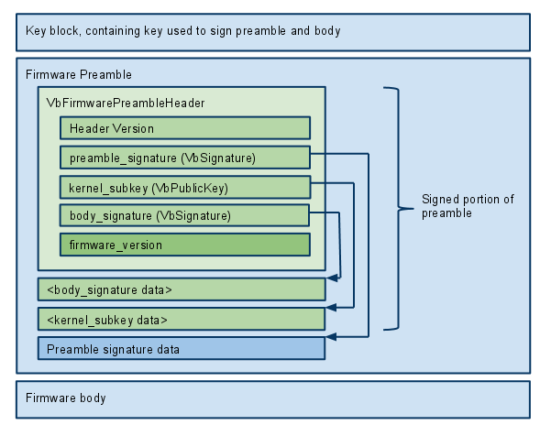
Firmware image
A firmware image consists of a key block, a firmware preamble, and the firmware body. The key block, preamble, and body do not directly point to each other, so they can be read into separate blocks of memory. The firmware preamble is signed by the key block, and contains the signature of the firmware body plus another subkey which will be used to validate the kernel image.

Slide 19
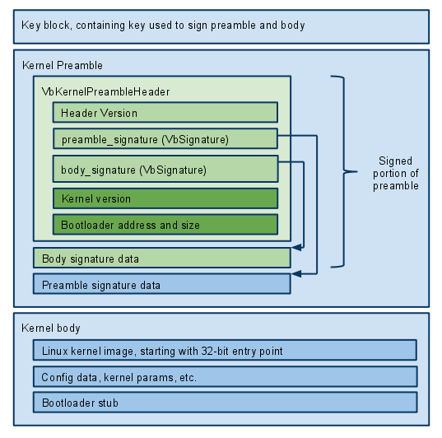
Kernel image
A kernel image consists of a key block, a kernel preamble, and the kernel body. The key block, preamble, and body do not directly point to each other, so they can be read into separate blocks of memory.

Slide 20
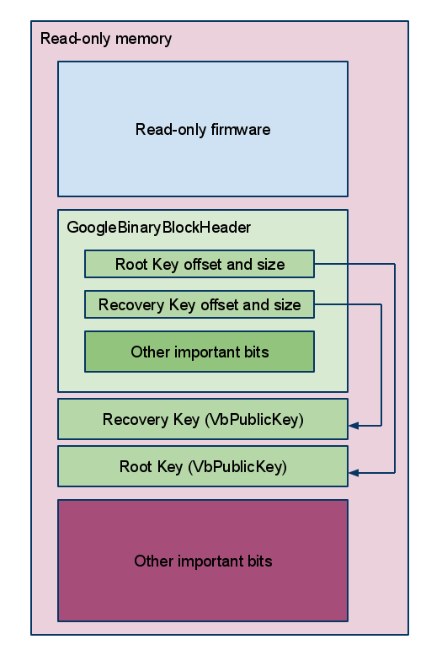
Root of trust
When the device is first powered on, it begins execution from a read-only section of flash memory. In addition to (hopefully) secure code, that read-only region contains the primary root keys needed to validate all the rest of the signed images. The structure that locates the root keys and various other read-only components is the GoogleBinaryBlockHeader, or ”GBB”
There are two primary keys in the GBB. The root key is used in the normal boot sequence to sign the read/write firmware, which contains subkeys to sign the kernel, and so forth. In recovery mode, only the read-only firmware is executed (because the read/write firmware may have been erased), so the kernel image on the removable drive is signed by the recovery key
There are a total of six separate keypairs involved in the complete boot process.

Slide 21
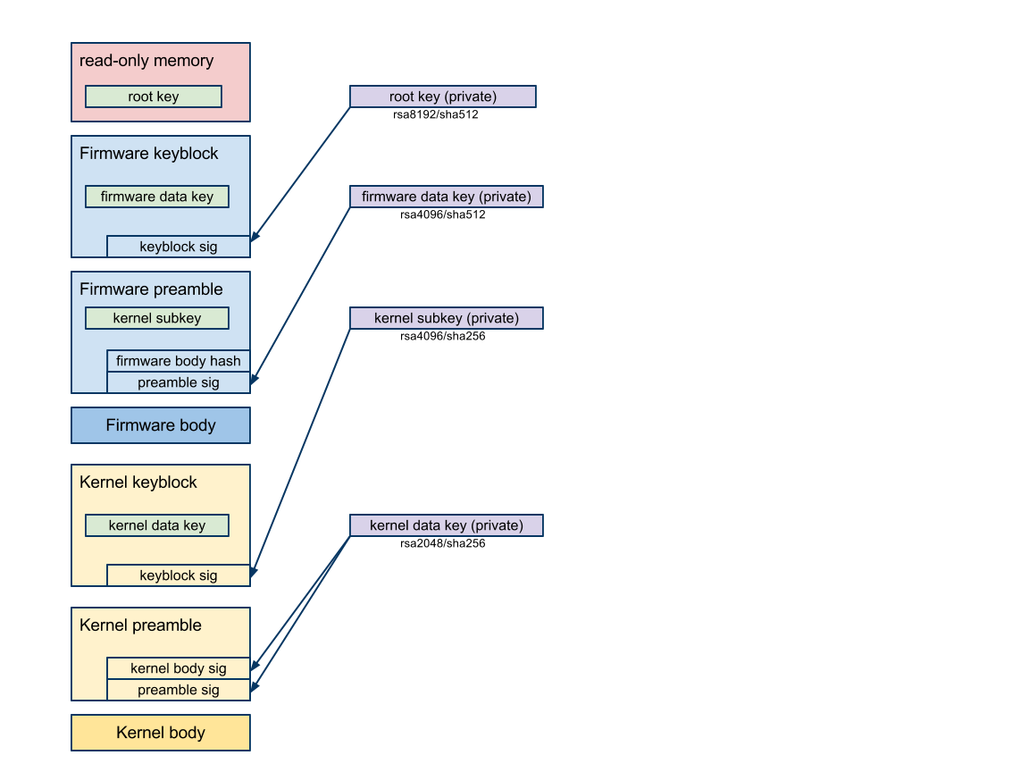
Normal boot
Read-only firmware looks in the GBB, finds the root key in read-only memory.
The root key validates the read/write firmware’s keyblock, which contains the firmware data key.
The firmware data key validates the firmware preamble (which contains the kernel subkey) and the read/write firmware body.
The read/write firmware begins execution.
The read/write firmware uses the kernel subkey to validate the kernel’s keyblock, which contains the kernel data key.
The kernel data key validates the kernel preamble and the kernel blob.
The kernel begins execution.
The kernel image contains the hash of hashes, which is used to validate the bundle of hashes used by the block-based rootfs validation scheme.
The filesystem driver uses the bundle of hashes to validate each block of the rootfs as is read off the disk.

Slide 22
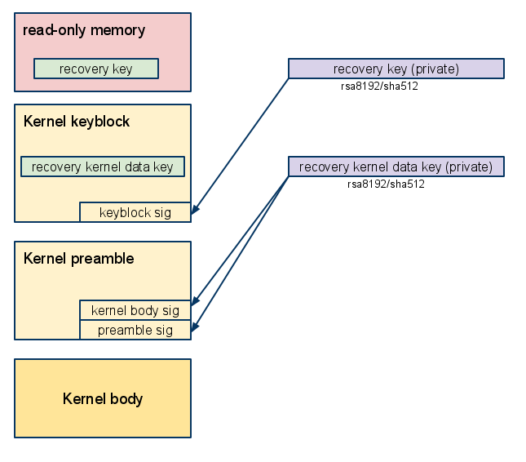
Recovery boot
Read-only firmware looks in the GBB, finds the recovery key in read-only memory.
The recovery key validates the kernel’s keyblock, which contains the recovery kernel data key. Although it serves the same purpose as the kernel subkey in normal boot, it uses a larger key because the read/write firmware is not used as an intermediate step.
The recovery kernel data key validates the kernel preamble and the kernel blob.
The kernel begins execution.
The kernel image contains the hash of hashes, which is used to validate the bundle of hashes used by the block-based rootfs validation scheme.
The filesystem driver uses the bundle of hashes to validate each block of the rootfs as it is read from the removable media.

Slide 23
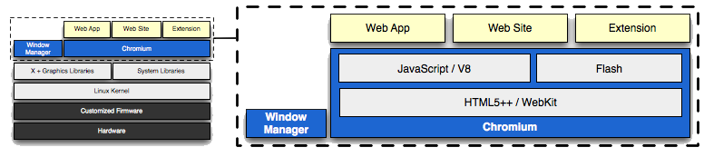
Chrome and the window manager

Slide 24




Some of the pics of the Chrome OS

Slide 25
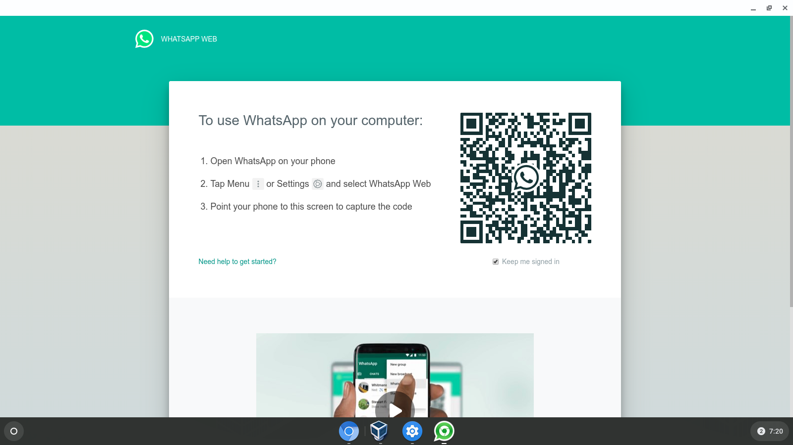
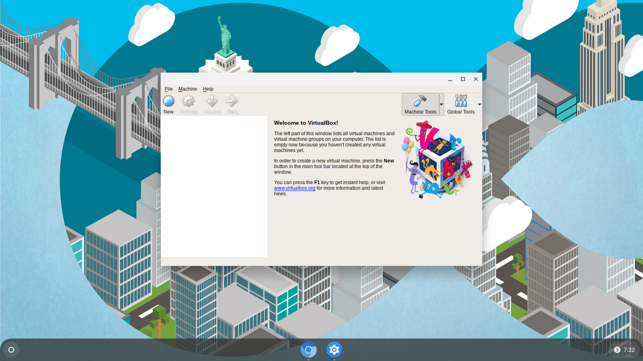
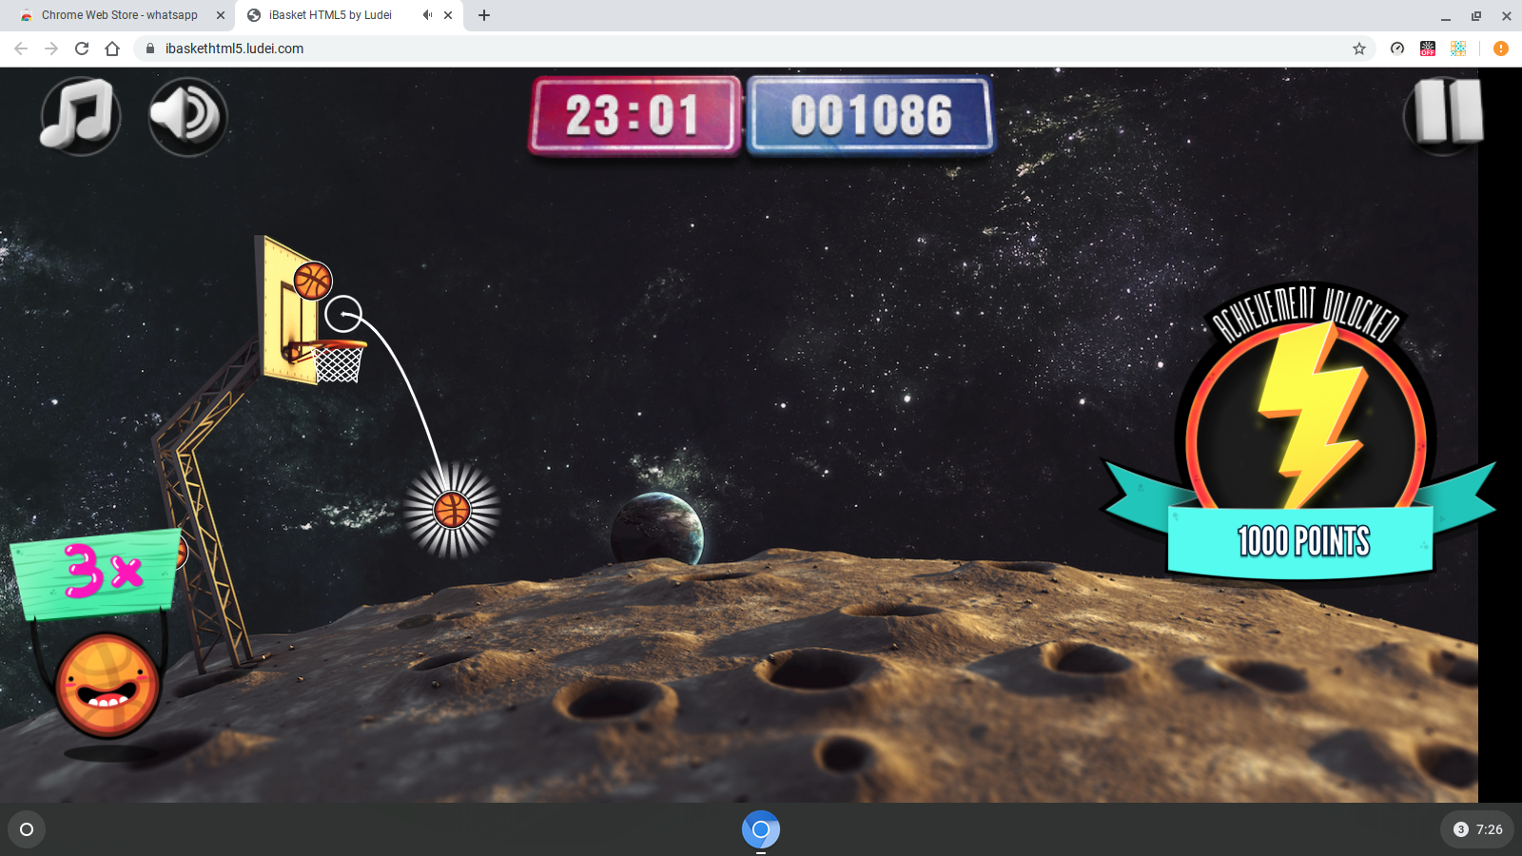
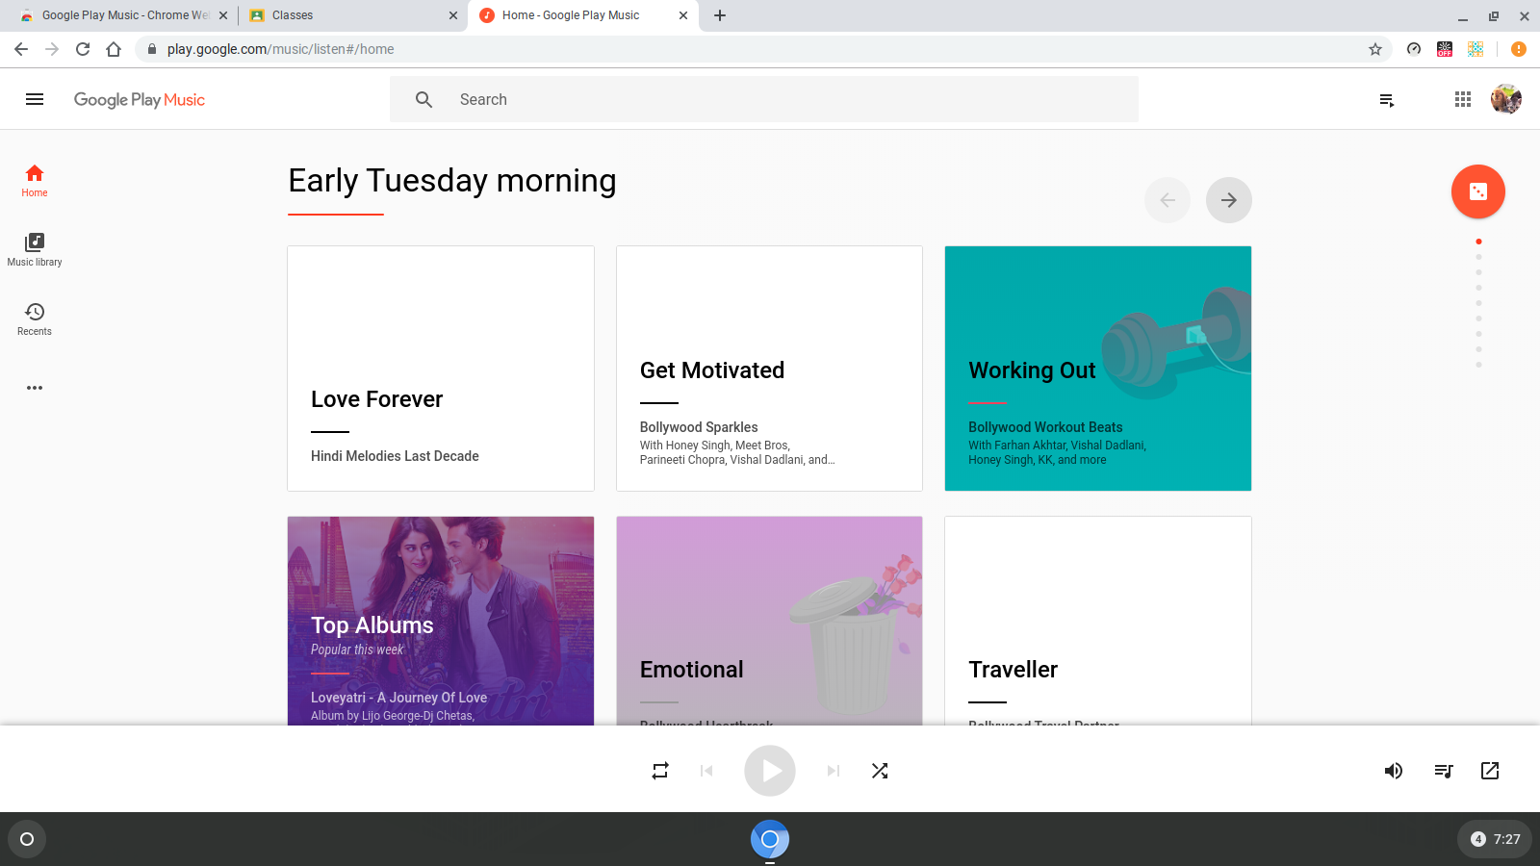
Some of the pics of the Chrome OS

Slide 26

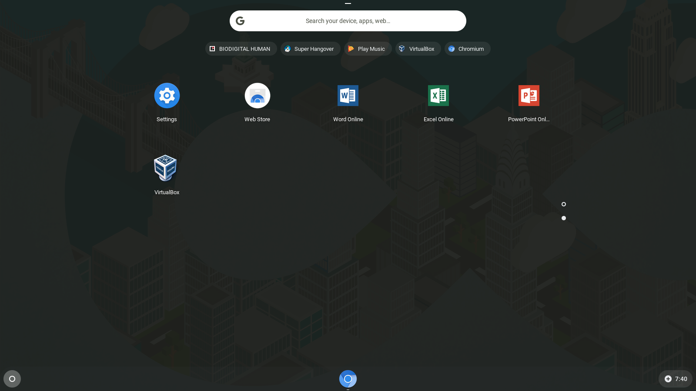
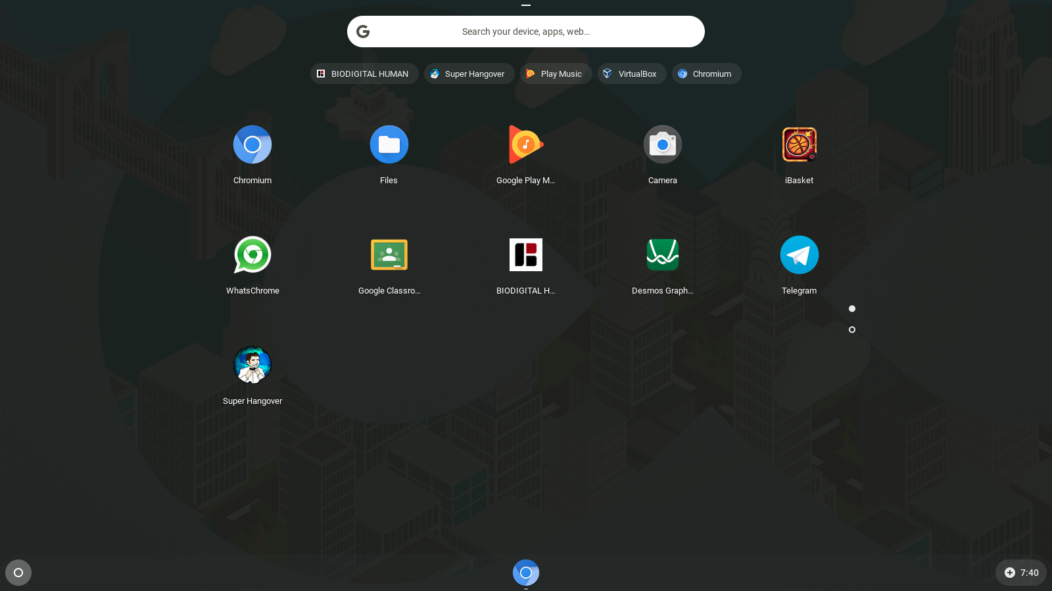
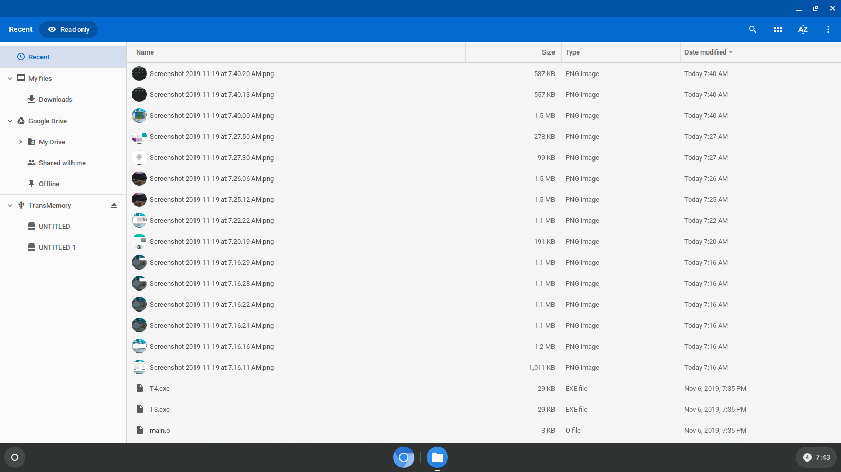
Some of the pics of the Chrome OS

Slide 27

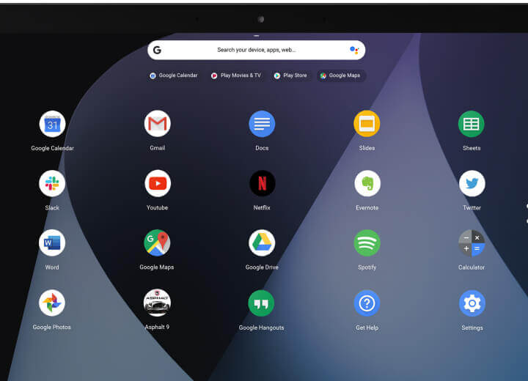
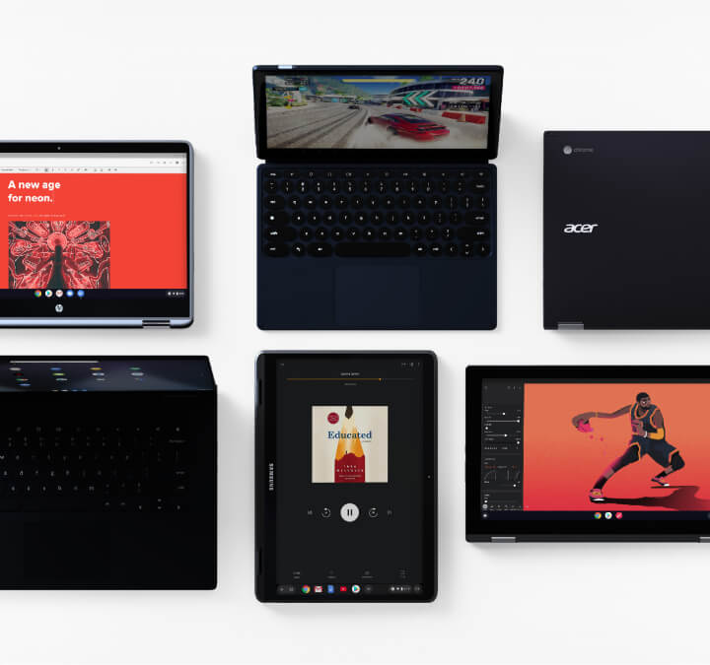

Some of the pics of the Chrome OS

Slide 28
THANK YOU

